Slide 1
DECODERS:
A decoder is a combinational circuit that converts binary information from n input lines to a maximum of 2^n ( ) unique output lines.
Each combination of inputs will assert a unique output.
3-to-8 line decoder:
The three inputs are decoded into eight outputs, each representing one of the minterms of the three input variables.
A particular application of this decoder is binary-to-octal conversion.

Slide 2
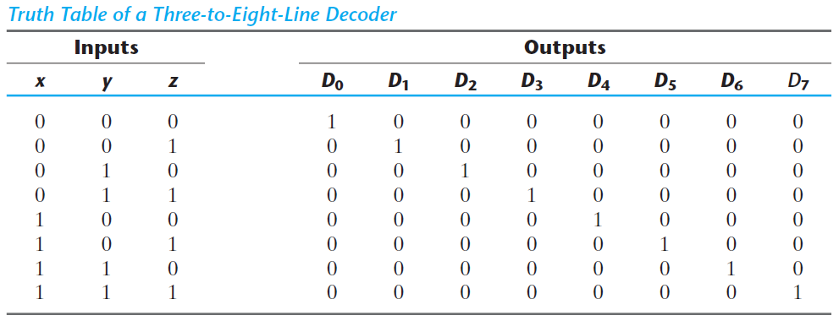

Slide 3
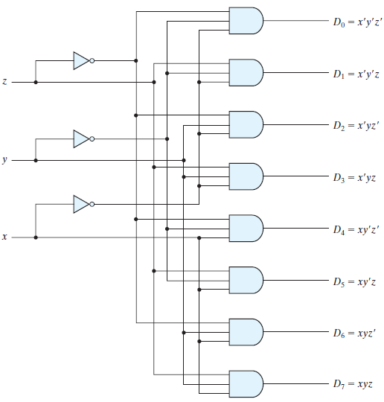
FIGURE: Three-to-eight-line decoder

Slide 4
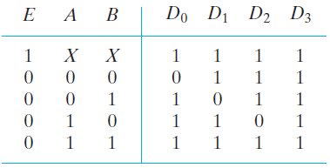
Some decoders are constructed with NAND gates. Since a NAND gate produces the AND operation with an inverted output, it becomes more economical to generate the decoder minterms in their complemented form.
Furthermore, decoders include one or more enable inputs to control the circuit operation.
Two-to-four-line decoder with an enable input constructed with NAND gates:
The decoder is enabled when E is equal to 0 (i.e., active-low enable).

Slide 5
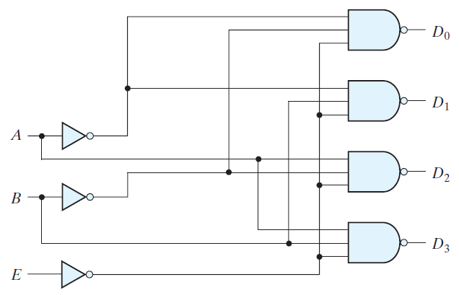

Slide 6
The enable input may be activated with a 0 or with a 1 signal. Some decoders have two or more enable inputs that must satisfy a given logic condition in order to enable the circuit.
A decoder with enable input can function as a demultiplexer— a circuit that receives information from a single line and directs it to one of 2^n possible output lines.
The decoder of above Fig. can function as a one-to-four-line demultiplexer when E is taken as a data input line and A and B are taken as the selection inputs.
Because decoder and demultiplexer operations are obtained from the same circuit, a decoder with an enable input is referred to as a decoder – demultiplexer.
Decoders with enable inputs can be connected together to form a larger decoder circuit.

Slide 7
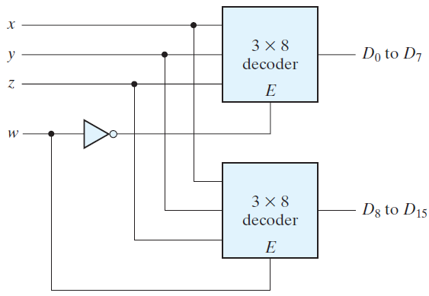
4-to-16-line decoder using 2, 3-to-8-line decoders with enable inputs.
FIGURE: 4 x16 decoder constructed with two 3x8 decoders

Slide 8

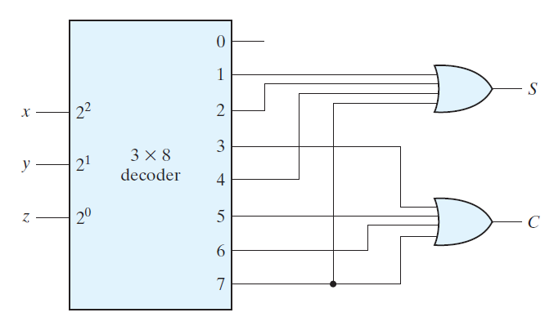
Combinational Logic Implementation:
FIGURE: Implementation of a full adder with a decoder

Slide 9
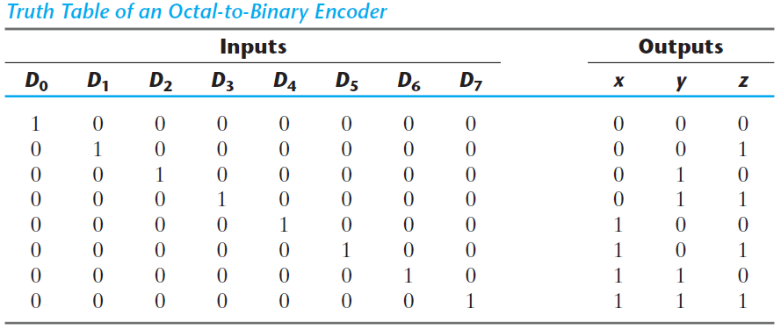
ENCODERS:
An encoder is a digital circuit that performs the inverse operation of a decoder. An encoder has 2^n (or fewer) input lines and n output lines. The output lines, as an aggregate, generate the binary code corresponding to the input value. An example of an encoder is the octal-to-binary encoder whose truth table is given in the following Table.

Slide 10
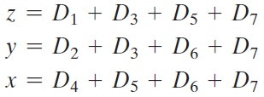
Priority Encoder:
A priority encoder is an encoder circuit that includes the priority function.
The operation of the priority encoder is such that if two or more inputs are equal to 1 at the same time, the input having the highest priority will take precedence.
The truth table of a four-input priority encoder is given in the following Table.
In addition to the two outputs x and y , the circuit has a third output designated by V ; this is a valid bit indicator that is set to 1 when one or more inputs are equal to 1.

Slide 11
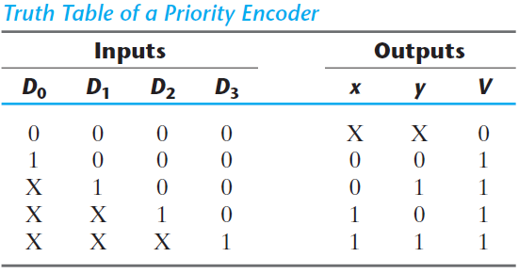
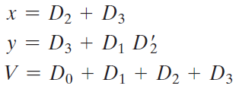

Slide 12
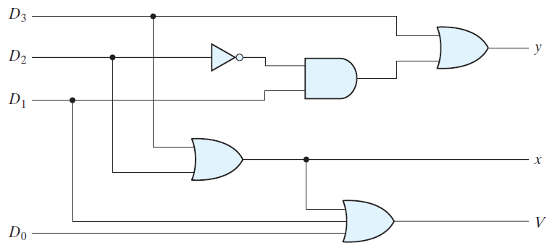
FIGURE: Four-input priority encoder

Slide 13
HDL MODELS OF COMBINATIONAL CIRCUITS:
The logic of a module can be described in any one (or a combination) of the following modeling styles:
• Gate-level modeling using instantiations of predefined and user-defined primitive gates.
• Dataflow modeling using continuous assignment statements with the keyword assign.
• Behavioral modeling using procedural assignment statements with the keyword always.
Gate-level (structural) modeling describes a circuit by specifying its gates and how they are connected with each other. Dataflow modeling is used mostly for describing the Boolean equations of combinational logic.
There is one other modeling style, called switch-level modeling. It is sometimes used in the simulation of MOS transistor circuit models, but not in logic synthesis.

Slide 14
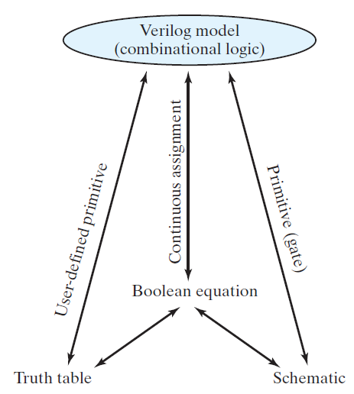
FIGURE: Relationship of Verilog constructs to truth tables, Boolean equations, and schematics

Slide 15
Gate-Level Modeling:
In this type of representation, a circuit is specified by its logic gates and their interconnections.
Gatelevel modeling provides a textual description of a schematic diagram.
The Verilog HDL includes 12 basic gates as predefined primitives. Four of these primitive gates are of the three-state type.
They are all declared with the lowercase keywords and, nand, or, nor, xor, xnor, not, and buf. Primitives such as and are n -input primitives. They can have any number of scalar inputs (e.g., a three-input and primitive).
The buf and not primitives are n -output primitives. A single input can drive multiple output lines distinguished by their identifiers.

Slide 16
The logic of each gate is based on a four-valued system. When the gates are simulated, the simulator assigns one value to the output of each gate at any instant. In addition to the two logic values of 0 and 1, there are two other values: unknown and high impedance.
When a primitive gate is listed in a module, we say that it is instantiated in the module. Think of instantiation as the HDL counterpart of placing and connecting parts on a circuit board.
The following Verilog statements specify two vectors:
output [0: 3] D;
wire [7: 0] SUM;

Slide 17
HDL Example (Two-to-Four-Line Decoder)

Slide 18
// Gate-level description of two-to-four-line decoder
module decoder_2x4_gates (D, A, B, enable);
output [0: 3] D;
input A, B;
input enable;
wire A_not, B_not, enable_not;
not
G1 (A_not, A),
G2 (B_not, B),
G3 (enable_not, enable);
nand
G4 (D[0], A_not, B_not, enable_not),
G5 (D[1], A_not, B, enable_not),
G6 (D[2], A, B_not, enable_not),
G7 (D[3], A, B, enable_not);
endmodule

Slide 19
Hierarchical description of a design:
Two or more modules can be combined to build a hierarchical description of a design. There are two basic types of design methodologies: top down and bottom up.
In a top-down design, the top-level block is defined and then the sub-blocks necessary to build the top-level block are identified.
In a bottom-up design, the building blocks are first identified and then combined to build the top-level block.
Take, for example, the 4-bit binary adder. It can be considered as a top-block component built with four full-adder blocks, while each full adder is built with two half-adder blocks.
In a top-down design, the four-bit adder is defined first, and then the two adders are described.

Slide 20
In a bottom-up design, the half adder is defined, then each full adder is constructed, and then the four-bit adder is built from the full adders.
A bottom-up hierarchical description of a four-bit adder is shown in the following HDL Example.
The half adder is defined by instantiating primitive gates.
The next module describes the full adder by instantiating and connecting two half adders.
The third module describes the four-bit adder by instantiating and connecting four full adders.

Slide 21
HDL Example (Ripple-Carry Adder)
// Gate-level description of four-bit ripple carry adder
// Description of half adder
module half_adder ( output S, C, input x, y);
// Instantiate primitive gates
xor (S, x, y);
and (C, x, y);
endmodule
// Description of full adder
module full_adder ( output S, C, input x, y, z);
wire S1, C1, C2;
// Instantiate half adders
half_adder HA1 (S1, C1, x, y);
half_adder HA2 (S, C2, S1, z);
or G1 (C, C2, C1);
endmodule

Slide 22
// Description of four-bit adder
module ripple_carry_4_bit_adder ( output [3: 0] Sum, output C4, input [3: 0] A, B, input C0);
wire C1, C2, C3; // Intermediate carries
// Instantiate chain of full adders
full_adder FA0 (Sum[0], C1, A[0], B[0], C0),
FA1 (Sum[1], C2, A[1], B[1], C1),
FA2 (Sum[2], C3, A[2], B[2], C2),
FA3 (Sum[3], C4, A[3], B[3], C3);
endmodule

Slide 23
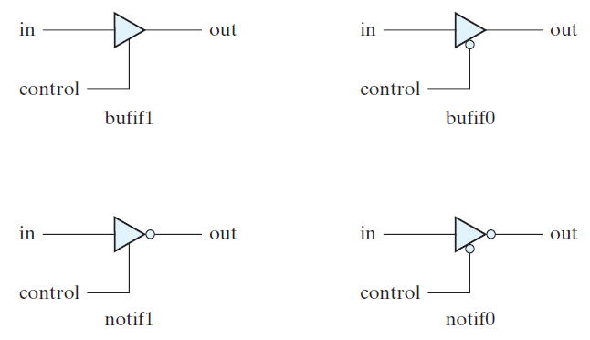
Three-State Gates:
A three-state gate has a control input that can place the gate into a high-impedance state.
There are four types of three-state gates, as shown below.
FIGURE: Three-state gates

Slide 24
The bufif1 gate behaves like a normal buffer if control = 1. The output goes to a high-impedance state z when control = 0.
The bufif0 gate behaves in a similar fashion, except that the high-impedance state occurs when control = 1.
The two notif gates operate in a similar manner.
The gates are instantiated with the statement
gatename (output, input, control);
The outputs of three-state gates can be connected together to form a common output line.
To identify such a connection, Verilog HDL uses the keyword tri (for tristate) to indicate that the output has multiple drivers.
As an example, consider the two-to-one line multiplexer with three-state gates as shown in following Figure.

Slide 25
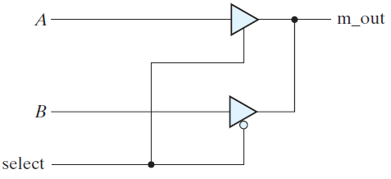
FIGURE: Two-to-one-line multiplexer with three-state buffers
// Mux with three-state output
module mux_tri (m_out, A, B, select);
output m_out;
input A, B, select;
tri m_out;
bufif1 (m_out, A, select);
bufif0 (m_out, B, select);
endmodule

Slide 26
The 2 three-state buffers have the same output. In order to show that they have a common connection, it is necessary to declare m_out with the keyword tri.
Dataflow Modeling:
Dataflow modeling of combinational logic uses a number of operators that act on binary operands to produce a binary result.
It should be noted that a bitwise operator (e.g. , ) and its corresponding logical operator (e.g., ! ) may produce different results, depending on their operand.
If the operands are scalar the results will be identical; if the operands are vectors the result will not necessarily match.
For example, (1010) is (0101), and !(1010) is 0. A binary value is considered to be logically true if it is not 0. In general, use the bitwise operators to describe arithmetic operations and the logical operators to describe logical operations.

Slide 27
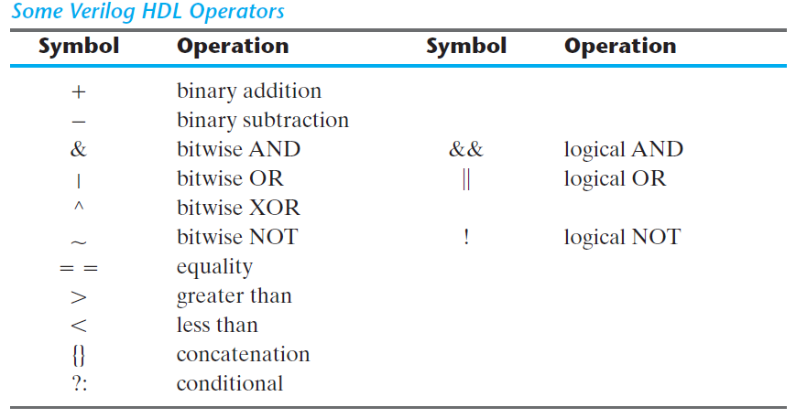

Slide 28
HDL Example (Dataflow: Two-to-Four Line Decoder):
// Dataflow description of two-to-four-line decoder
// See Fig. Note: The figure uses symbol E, but the
// Verilog model uses enable to clearly indicate functionality.
module decoder_2x4_df (output [0: 3] D, input A, B, enable);
assign D[0] = !((!A) && (!B) && (!enable)),
D[1] = !((!A) && B && (!enable)),
D[2] = !(A && (!B) && (!enable)),
D[3] = !(A && B && (!enable));
endmodule

Slide 29
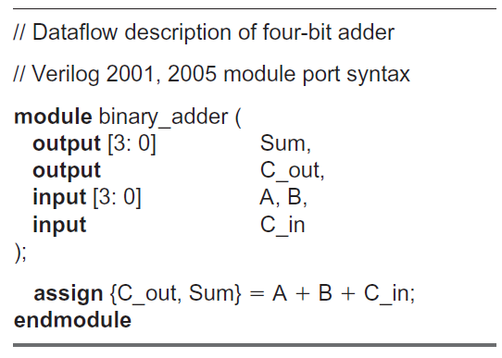
HDL Example (Dataflow: Four-Bit Adder):

Slide 30
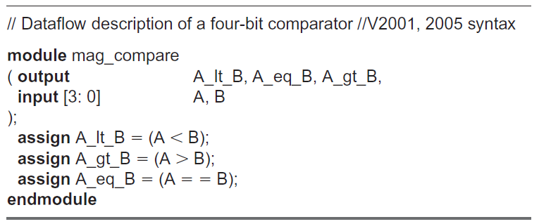
Dataflow HDL models describe combinational circuits by their function rather than by their gate structure.
HDL Example (Dataflow: Four-Bit Comparator)

Slide 31
The next example uses the conditional operator ( ? : ). This operator takes three operands:
condition ? true-expression : false-expression;
The condition is evaluated.
If the result is logic 1, the true expression is evaluated and used to assign a value to the left-hand side of an assignment statement.
If the result is logic 0, the false expression is evaluated.
The two conditions together are equivalent to an if–else condition.
HDL Example describes a two-to-one-line multiplexer using the conditional operator. The continuous assignment
assign OUT = select ? A : B;
specifies the condition that OUT = A if select = 1, else OUT = B if select = 0.

Slide 32
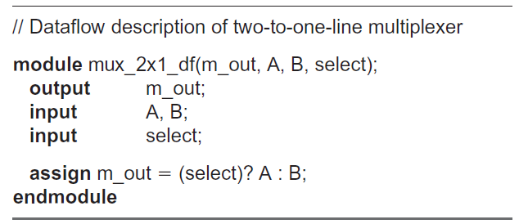
HDL Example (Dataflow: Two-to-One Multiplexer):
(Remember this module for writing test bench)
Behavioral Modeling:
Behavioral modeling represents digital circuits at a functional and algorithmic level. It is used mostly to describe sequential circuits, but can also be used to describe combinational circuits.

Slide 33
Behavioral descriptions use the keyword always , followed by an optional event control expression and a list of procedural assignment statements. The event control expression specifies when the statements will execute.
The target output of a procedural assignment statement must be of the reg data type. Contrary to the wire data type, whereby the target output of an assignment may be continuously updated, a reg data type retains its value until a new value is assigned.
Following HDL Example shows the behavioral description of a two-to-one-line multiplexer. Since variable m_out is a target output, it must be declared as reg data (in addition to the output declaration). The procedural assignment statements inside the always block are executed every time there is a change in any of the variables listed after the @ symbol. (Note that there is no semicolon (;) at the end of the always statement.)

Slide 34
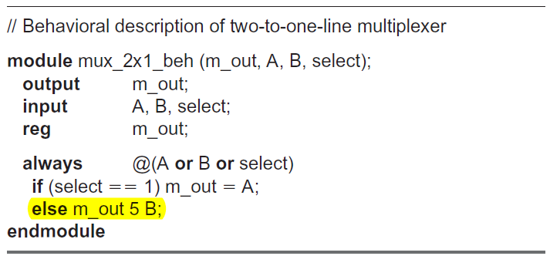
HDL Example (Behavioral: Two-to-One Line Multiplexer):
The conditional statement if–else provides a decision based upon the value of the select input. The if statement can be written without the equality symbol:
if (select) OUT = A;
The statement implies that select is checked for logic 1.

Slide 35
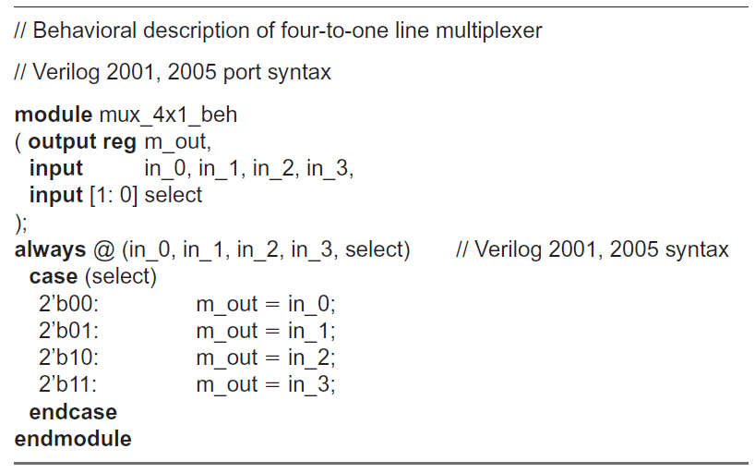
HDL Example (Behavioral: Four-to-One Line Multiplexer)

Slide 36
Binary numbers in Verilog are specified and interpreted with the letter b preceded by a prime. The size of the number is written first and then its value.
Numbers are stored as a bit pattern in memory, but they can be referenced in decimal, octal, or hexadecimal formats with the letters d` o`, and h`, respectively. For example, 4`HA = 4`d10 = 4`b1010 and have the same internal representation in a simulator.
If the base of the number is not specified, its interpretation defaults to decimal.
If the size of the number is not specified, the system assumes that the size of the number is at least 32 bits.

Slide 37
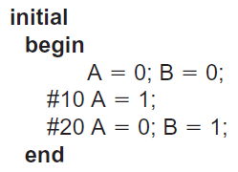
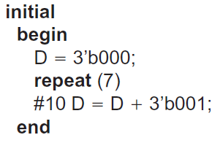
Writing a Simple Test Bench:
In a test bench, the initial statement executes only once, starting from simulation time 0, and may continue with any operations that are delayed by a given number of time units, as specified by the symbol #. For example, consider the initial
block: (Following LHS statements).
Inputs specified by a three-bit truth table can be generated with the initial block: (RHS statements).

Slide 38
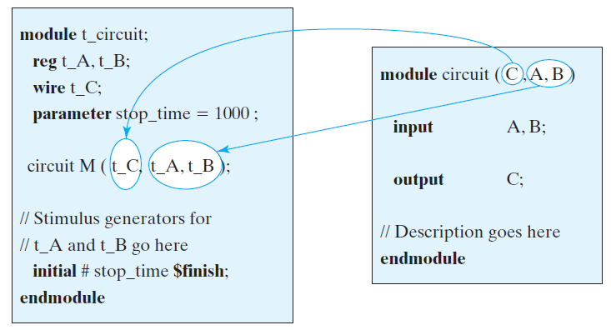
FIGURE: Interaction between stimulus and design modules

Slide 39
The response to the stimulus generated by the initial and always blocks will appear in text format as standard output and as waveforms (timing diagrams) in simulators having graphical output capability.
Numerical outputs are displayed by using Verilog system tasks . These are built-in system functions that are recognized by keywords that begin with the symbol $.
Some of the system tasks that are useful for display are:
$display —display a one-time value of variables or strings with an end-of-line return,
$write —same as $display , but without going to next line,
$monitor —display variables whenever a value changes during a simulation run,
$time —display the simulation time,
$finish —terminate the simulation.

Slide 40
The syntax for $display, $write, and $monitor is of the form
Task-name (format specification, argumentlist);
The format specification uses the symbol % to specify the radix of the numbers that are displayed and may have a string enclosed in quotes (“).
The base may be binary, decimal, hexadecimal, or octal, identified with the symbols %b, %d, %h, and %o, respectively (%B, %D, %H, and %O are valid too). For example, the statement
$display ("%d %b %b", C, A, B);
specifies the display of C in decimal and of A and B in binary. Note that there are no commas in the format specification, that the format specification and argument list are separated by a comma, and that the argument list has commas between the variables. An example that specifies a string enclosed in quotes may look like the statement

Slide 41
// reg a, b ; // a = 0 ; // b = 1 ; $display("The value of a is: %b", a) ; $write ("The value of b is: %b", b) ;
The console window displays the following:
The value of a is: 0
The value of b is: 1.
Notice that the $write task prints the results below the $display tasks. ($display adds a new line character). If you change the order of these tasks to make the $write task first, then the console window will display the following:
The value of b is: 1 The value of a is: 0
This is because the $write task does not add a new line character at the end of the line.

Slide 42
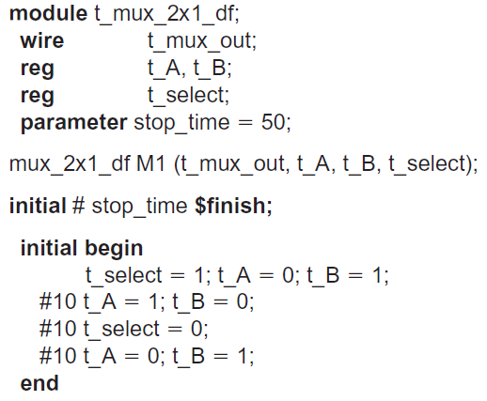
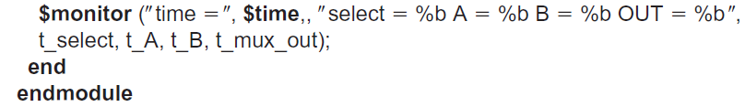
Test bench with stimulus for mux_2x1_df:
initial begin // Response monitor

Slide 43
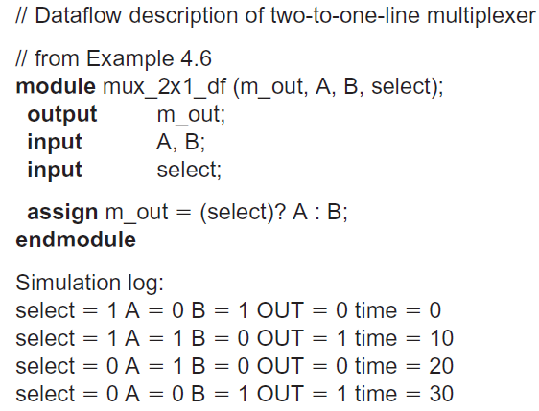

Slide 44
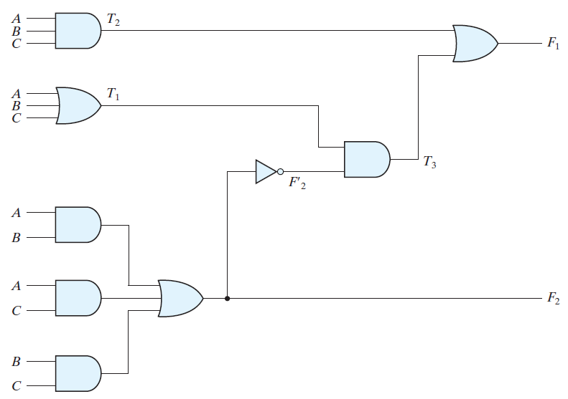
HDL Example (Gate-Level Circuit):

Slide 45
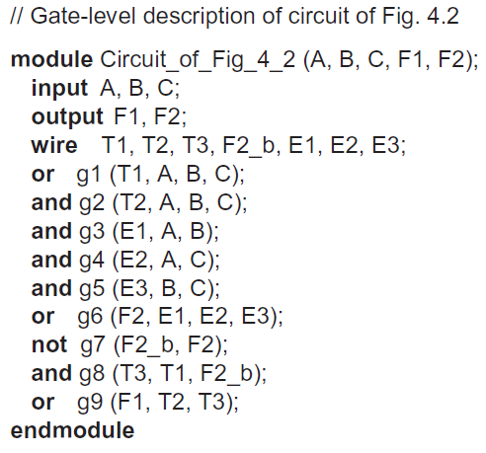

Slide 46
